Slide 1
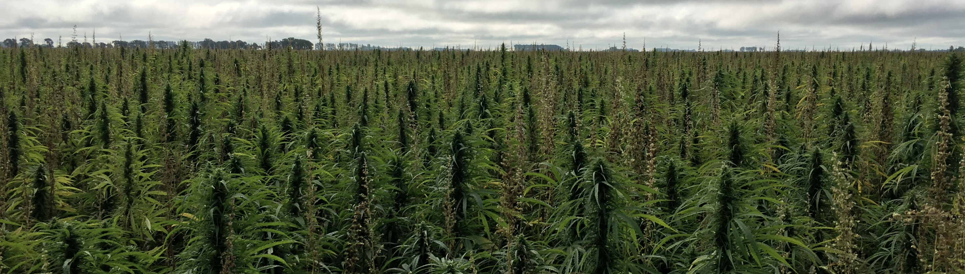
Minnesota Industrial Hemp Program
February 13, 2020

Slide 2
2014 Farm Bill
Established legal definition of hemp: “The plant Cannabis sativa with less than 0.3% delta-9 tetrahydrocannabinol (THC)”
Allowed to be grown within state’s pilot programs for research purposes
Hemp was considered a controlled substance by the federal government

Slide 3
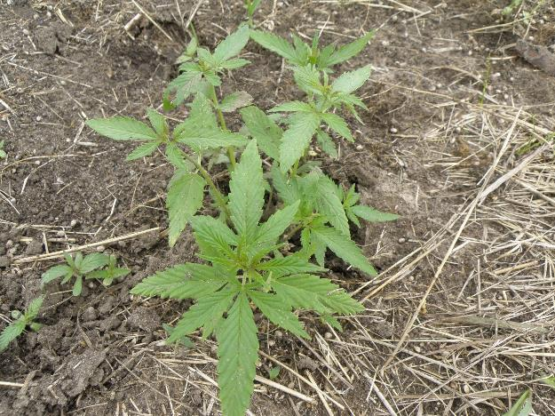
2018 Farm Bill
Expands the existing definition of industrial hemp from the 2014 Farm Bill to include “….. seeds thereof and all derivatives, extracts, cannabinoids, isomers, acids, salts, and salts of isomers……..”
Hemp is now an agricultural commodity overseen by USDA
States/Tribes must submit hemp regulatory plan to USDA for approval - including licensing growers and testing hemp fields for THC compliance

Slide 4

2018 Farm Bill
Amends federal Controlled Substances Act by excluding hemp from the definition of marijuana
Interstate commerce of hemp now fully legalized

Slide 5

2018 Farm Bill
Does not change the Food, Drug, and Cosmetic Act or section 351 of the Public Health Service Act
  CBD and other cannabinoids still considered illegal by FDA in food and dietary supplements
  Cannot make health or wellness claims on products

Slide 6
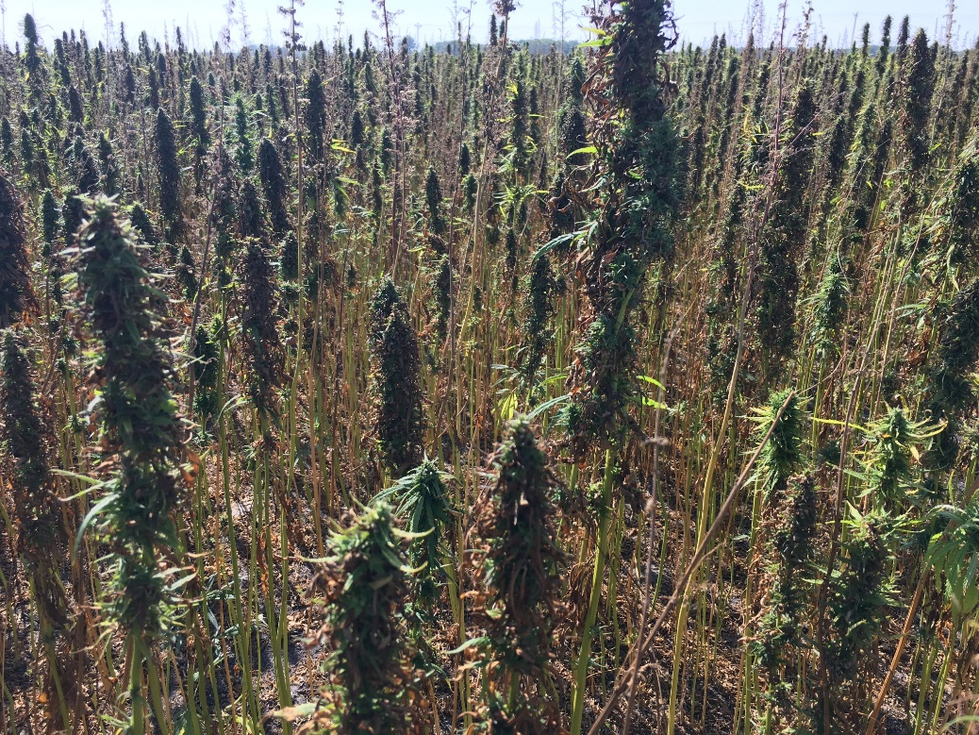
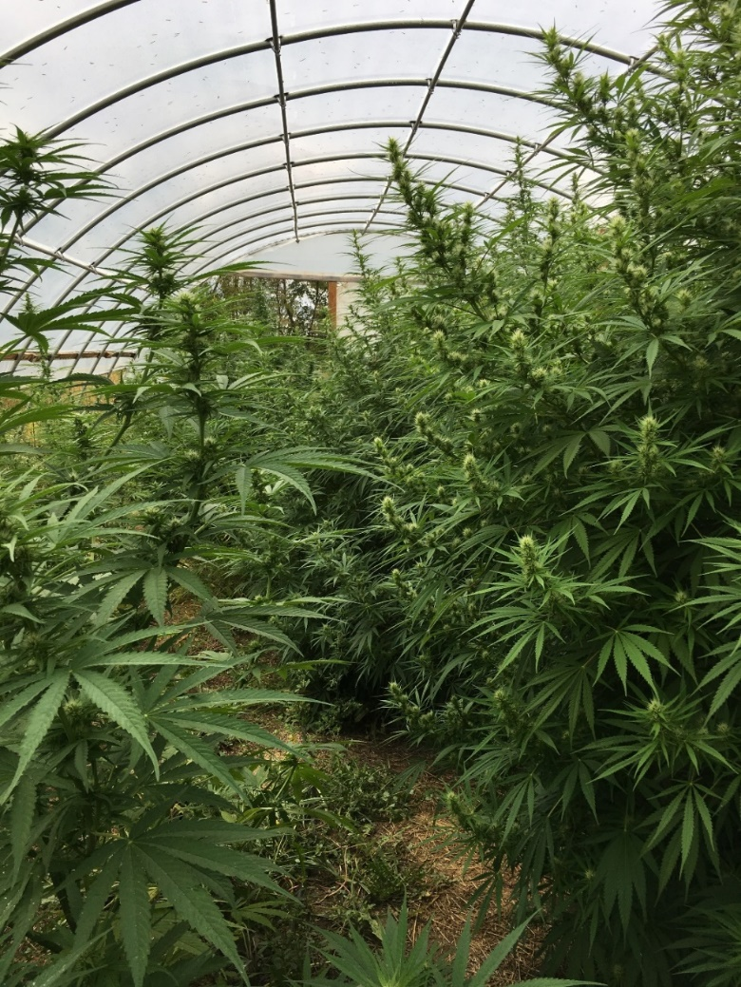
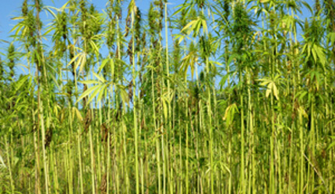
Three Main Types of Hemp Varieties
Fiber
Grain
CBD

Slide 7
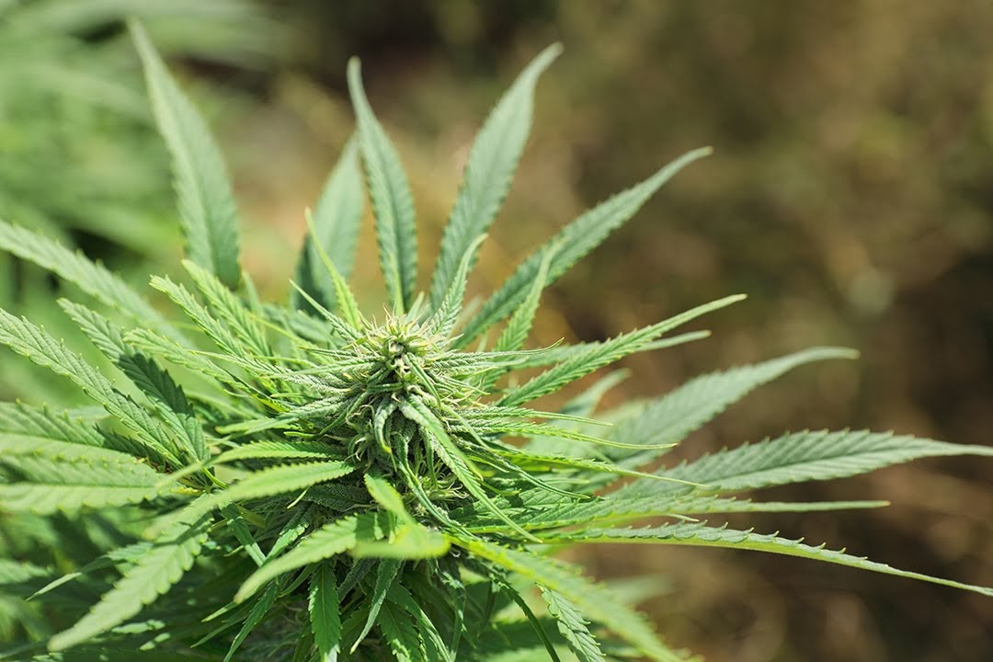
Minnesota Hemp Program
A license is required for growers and processors of raw hemp material or viable seed
License is obtained by applying online at the MDA website
All applicants must pass a criminal history background check—instructions on how to complete the check are mailed to the applicant after they apply online

Slide 8
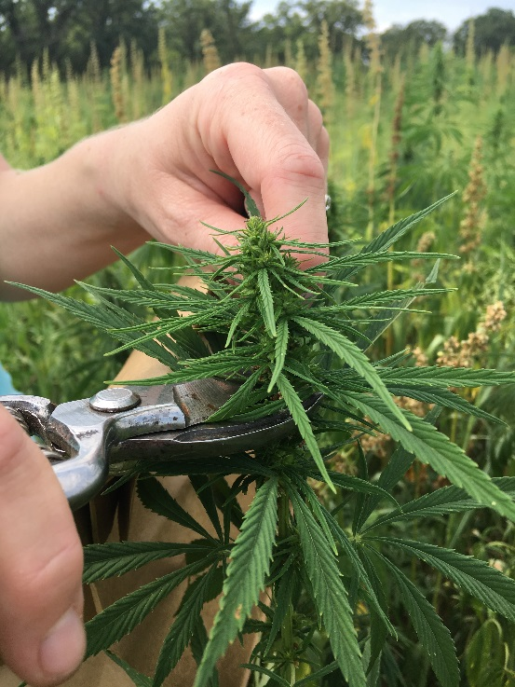
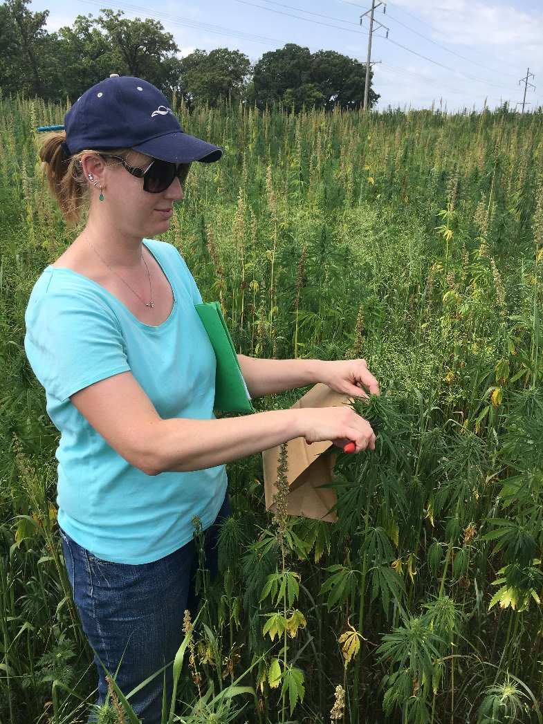
Field Inspection and Sampling
All fields are inspected and sampled for THC compliance
One sample per field
  30 plants per field, one 2-inch cutting per plant
  All plant material mixed into a single, homogenized sample

Slide 9
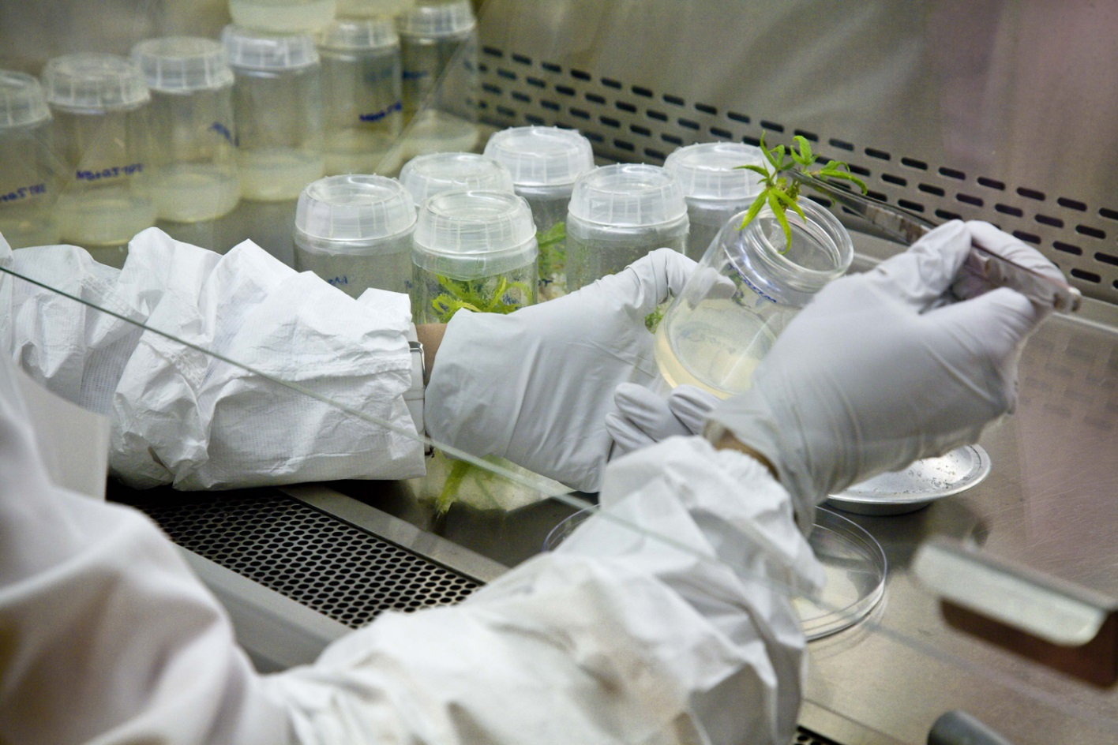
THC Testing
Legend Technical Services-Third-Party Accredited Lab
  Delta-9 tetrahydrocannabinol (d-9-THC)
  2018 Farm Bill requires us to look at Delta-9 THC post-decarboxylation (TOTAL THC = d-9 THC + THCA x 0.877)

Slide 10
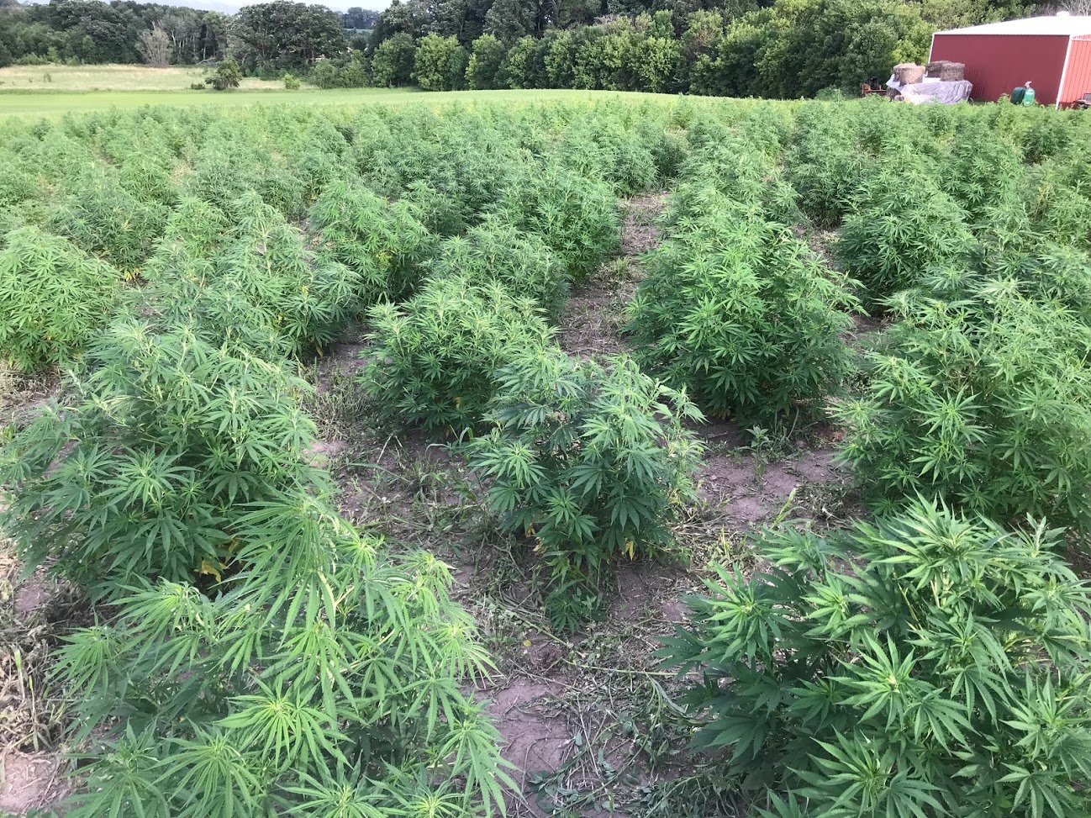
THC - Testing Compliance
In the event of a failed test…
  Grower can destroy crop or request a resampling/retest
  Mandatory crop destruction after 2 failed tests
  In 2019: 69 out of the 568 field samples failed (over 0.3% THC) = 12% failure rate

Slide 11
Minnesota Overview
Statistic | 2016 | 2017 | 2018 | 2019 | 2020*
Applicants | 7 | 47 | 65 | 723 | 342
Licensed Growers | 6 | 33 | 43 | 343
Licensed Processors/Handlers | 0 | 5 | 8 | 206
Outdoor Acreage Planted | 38 | 1,202 | 709 | 8,000
% Acres Planted For Grain | 94.7% | 99.3% | 87.9% | 21.7%
% Acres Planted For CBD | 0.0% | 0.4% | 10.1% | 78%
% Acres Planted For Fiber | 5.3% | 0.3% | 2.0% | 0.3%
*Data as of February 7, 2020

Slide 12
Minnesota Overview
CBD extractors - Currently 10-20 extractors operating in Minnesota and buying hemp flower from Minnesota growers
Hemp smokable market is growing as well
No fiber processors in the upper Midwest
Four companies offering contracts for grain and seed
  Canada (2)
  Wisconsin (1)
  Minnesota (1)

Slide 13
USDA Interim Rule
USDA issued interim rules on October 31, 2019
Effective until November 1, 2021
60-day comment period ended December 30, 2019
Along with the rule, it also posted guidelines for sampling hemp growing facilities, testing for identifying Delta-9 THC concentration in hemp, and lab reporting to USDA
Extended the 2014 pilot project authorization for one year.
Once again, clarified that interstate shipment of hemp is allowed.

Slide 14
USDA Interim Rule
The MDA held three listening sessions in November 2019
  Approximately 150 attended
Provided comments to USDA on January 2, 2020, outlining concerns on:
  Sampling and testing
  Laboratory approval
  Enforcement
  2020 growing season
Informed USDA Minnesota would remain under a pilot program in 2020
In talks with USDA regarding a state plan

Slide 15
Minnesota Industrial Hemp Program
February 13, 2020

